Slide 1
Ch.2 Yummy fruit
Practice 1

Slide 2

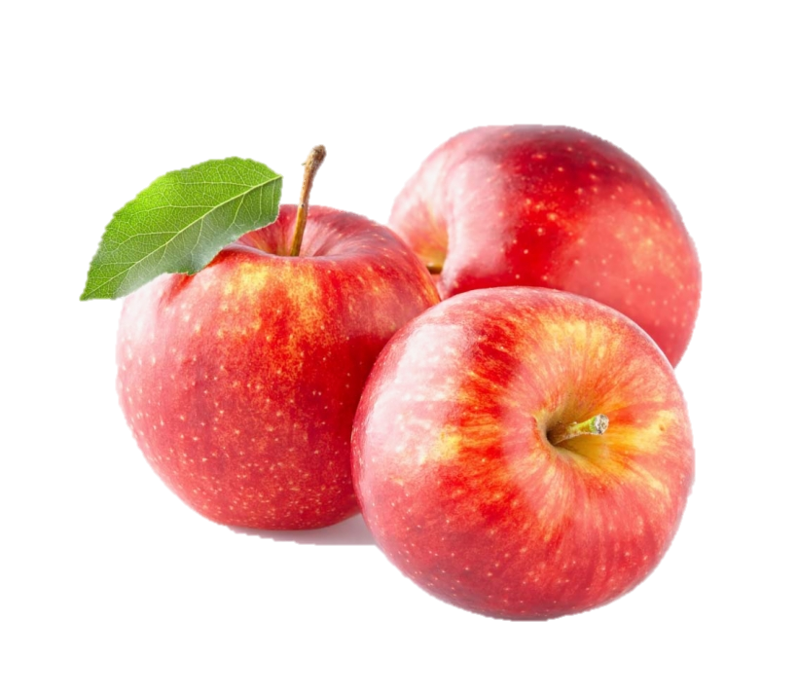

Do you remember the fruit we learnt?
What can you see?
當名詞數量多於一個時，需在名詞後+ ‘s’。
apples
Add ‘s’ for more than one thing.

Slide 3
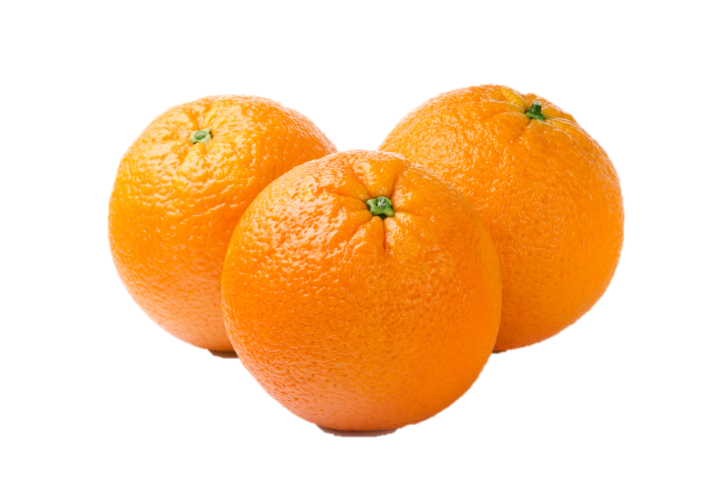
Do you remember the fruit we learnt?
What can you see?
oranges

Slide 4
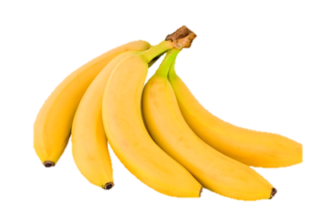
Do you remember the fruit we learnt?
What can you see?
bananas

Slide 5
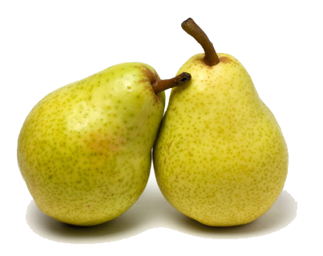
Do you remember the fruit we learnt?
What can you see?
pears

Slide 6
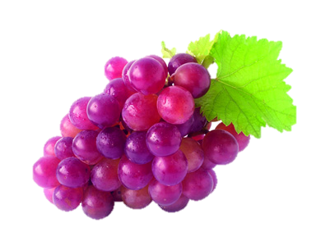
Do you remember the fruit we learnt?
What can you see?
grapes

Slide 7
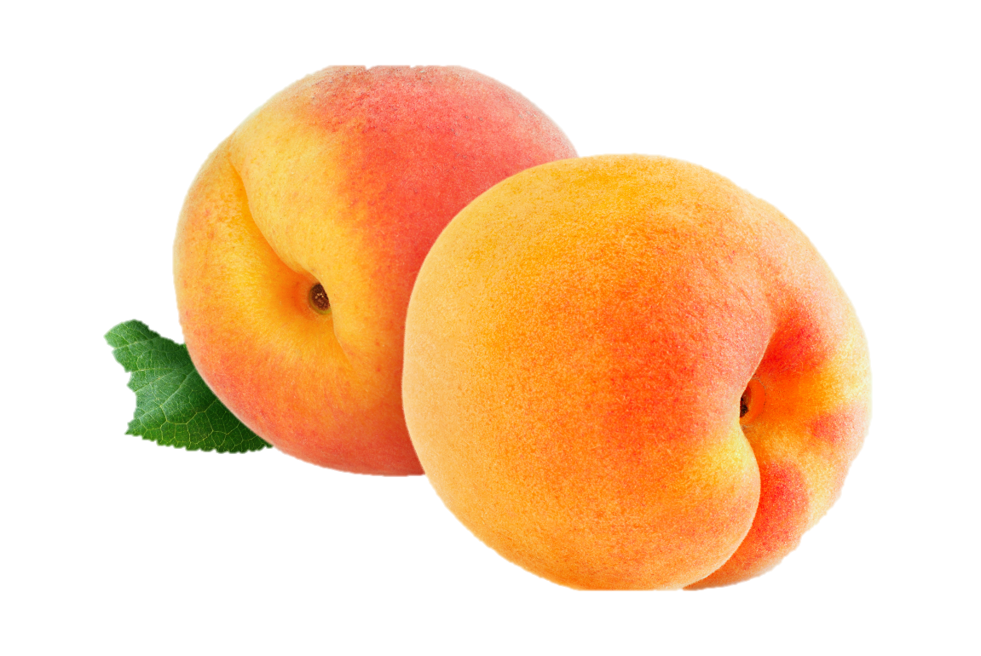
Do you remember the fruit we learnt?
What can you see?
以ch結尾的複數名詞，需在名詞後+ ‘es’。
peaches
Add ‘es’ for words ending in ‘-ch’.

Slide 8
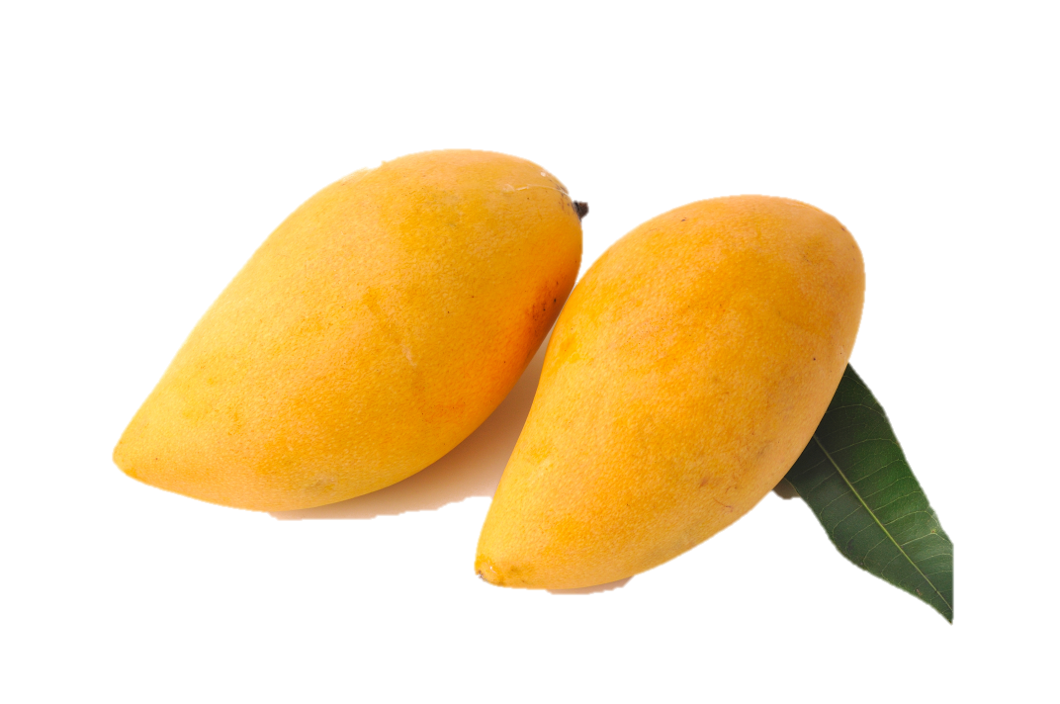
Do you remember the fruit we learnt?
What can you see?
以o結尾的複數名詞，需在名詞後+ ‘es’。
mangoes
Add ‘es’ for words ending in ‘-o’.

Slide 9
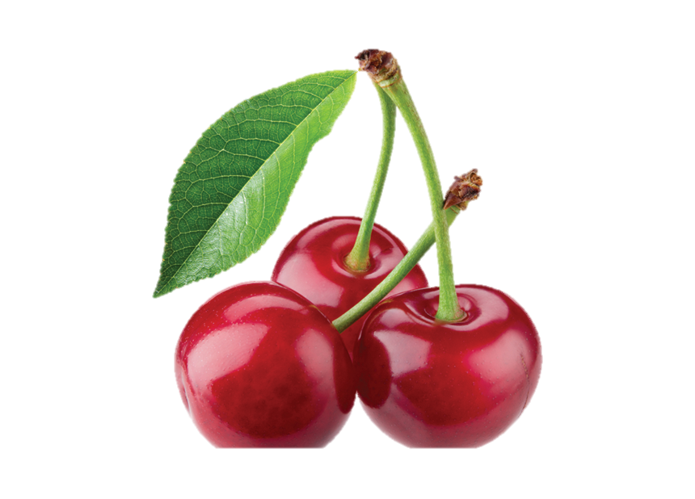
Do you remember the fruit we learnt?
What can you see?
以y結尾的名詞，轉為複數時需把名詞後的y改成 ‘ies’。
cherries
Change ‘-y’ to ‘-ies’:
cherry → cherries

Slide 10
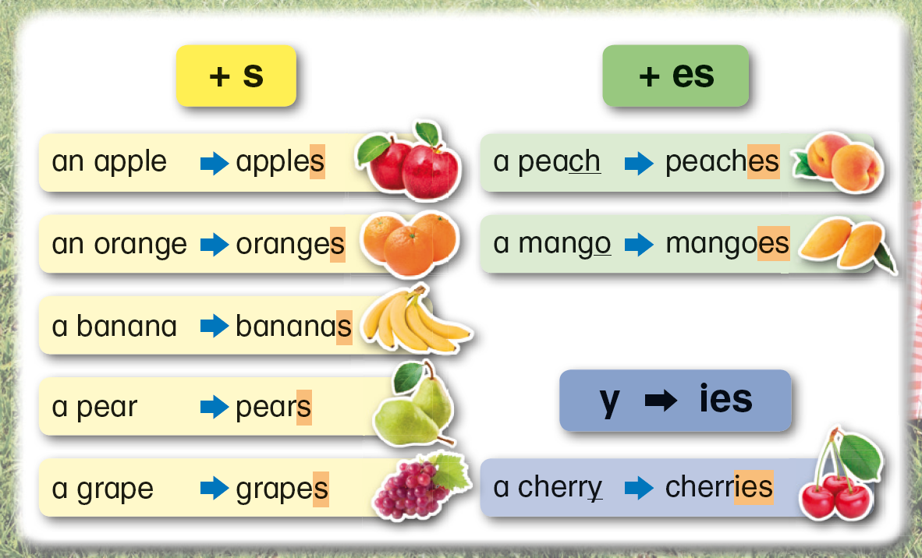
Here is how we form the plural form of some fruit names. 以下是一些水果變複數的規則。

Slide 11
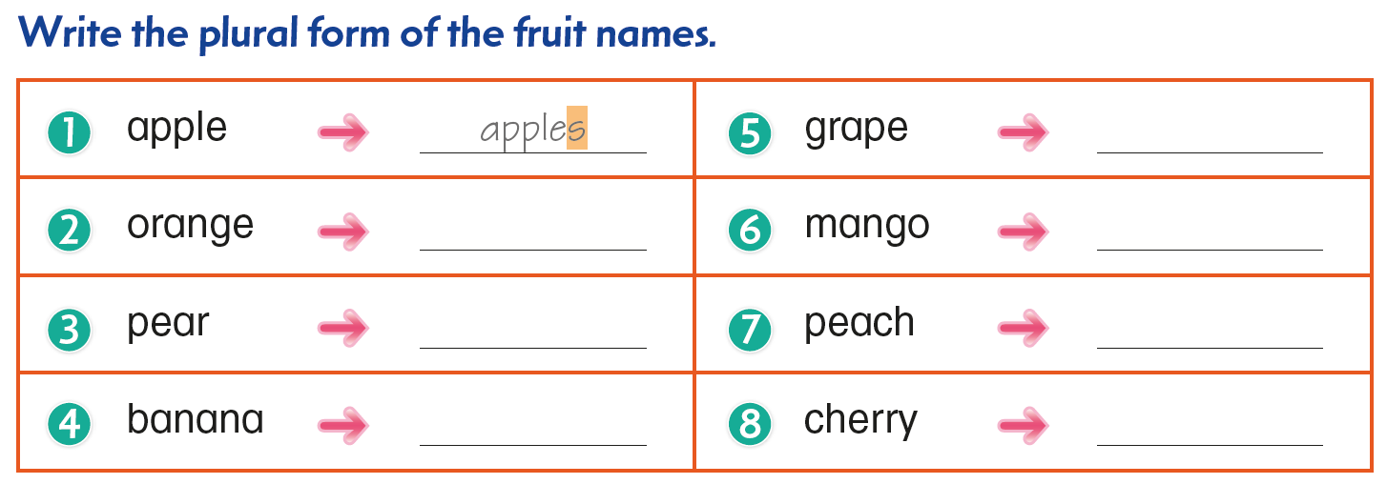
Turn your book to p.10 and try to do it. ☺

Slide 12
Turn your book to p.10 and try to do it. ☺
grapes
oranges
mangoes
pears
peaches
bananas
cherries

Slide 13

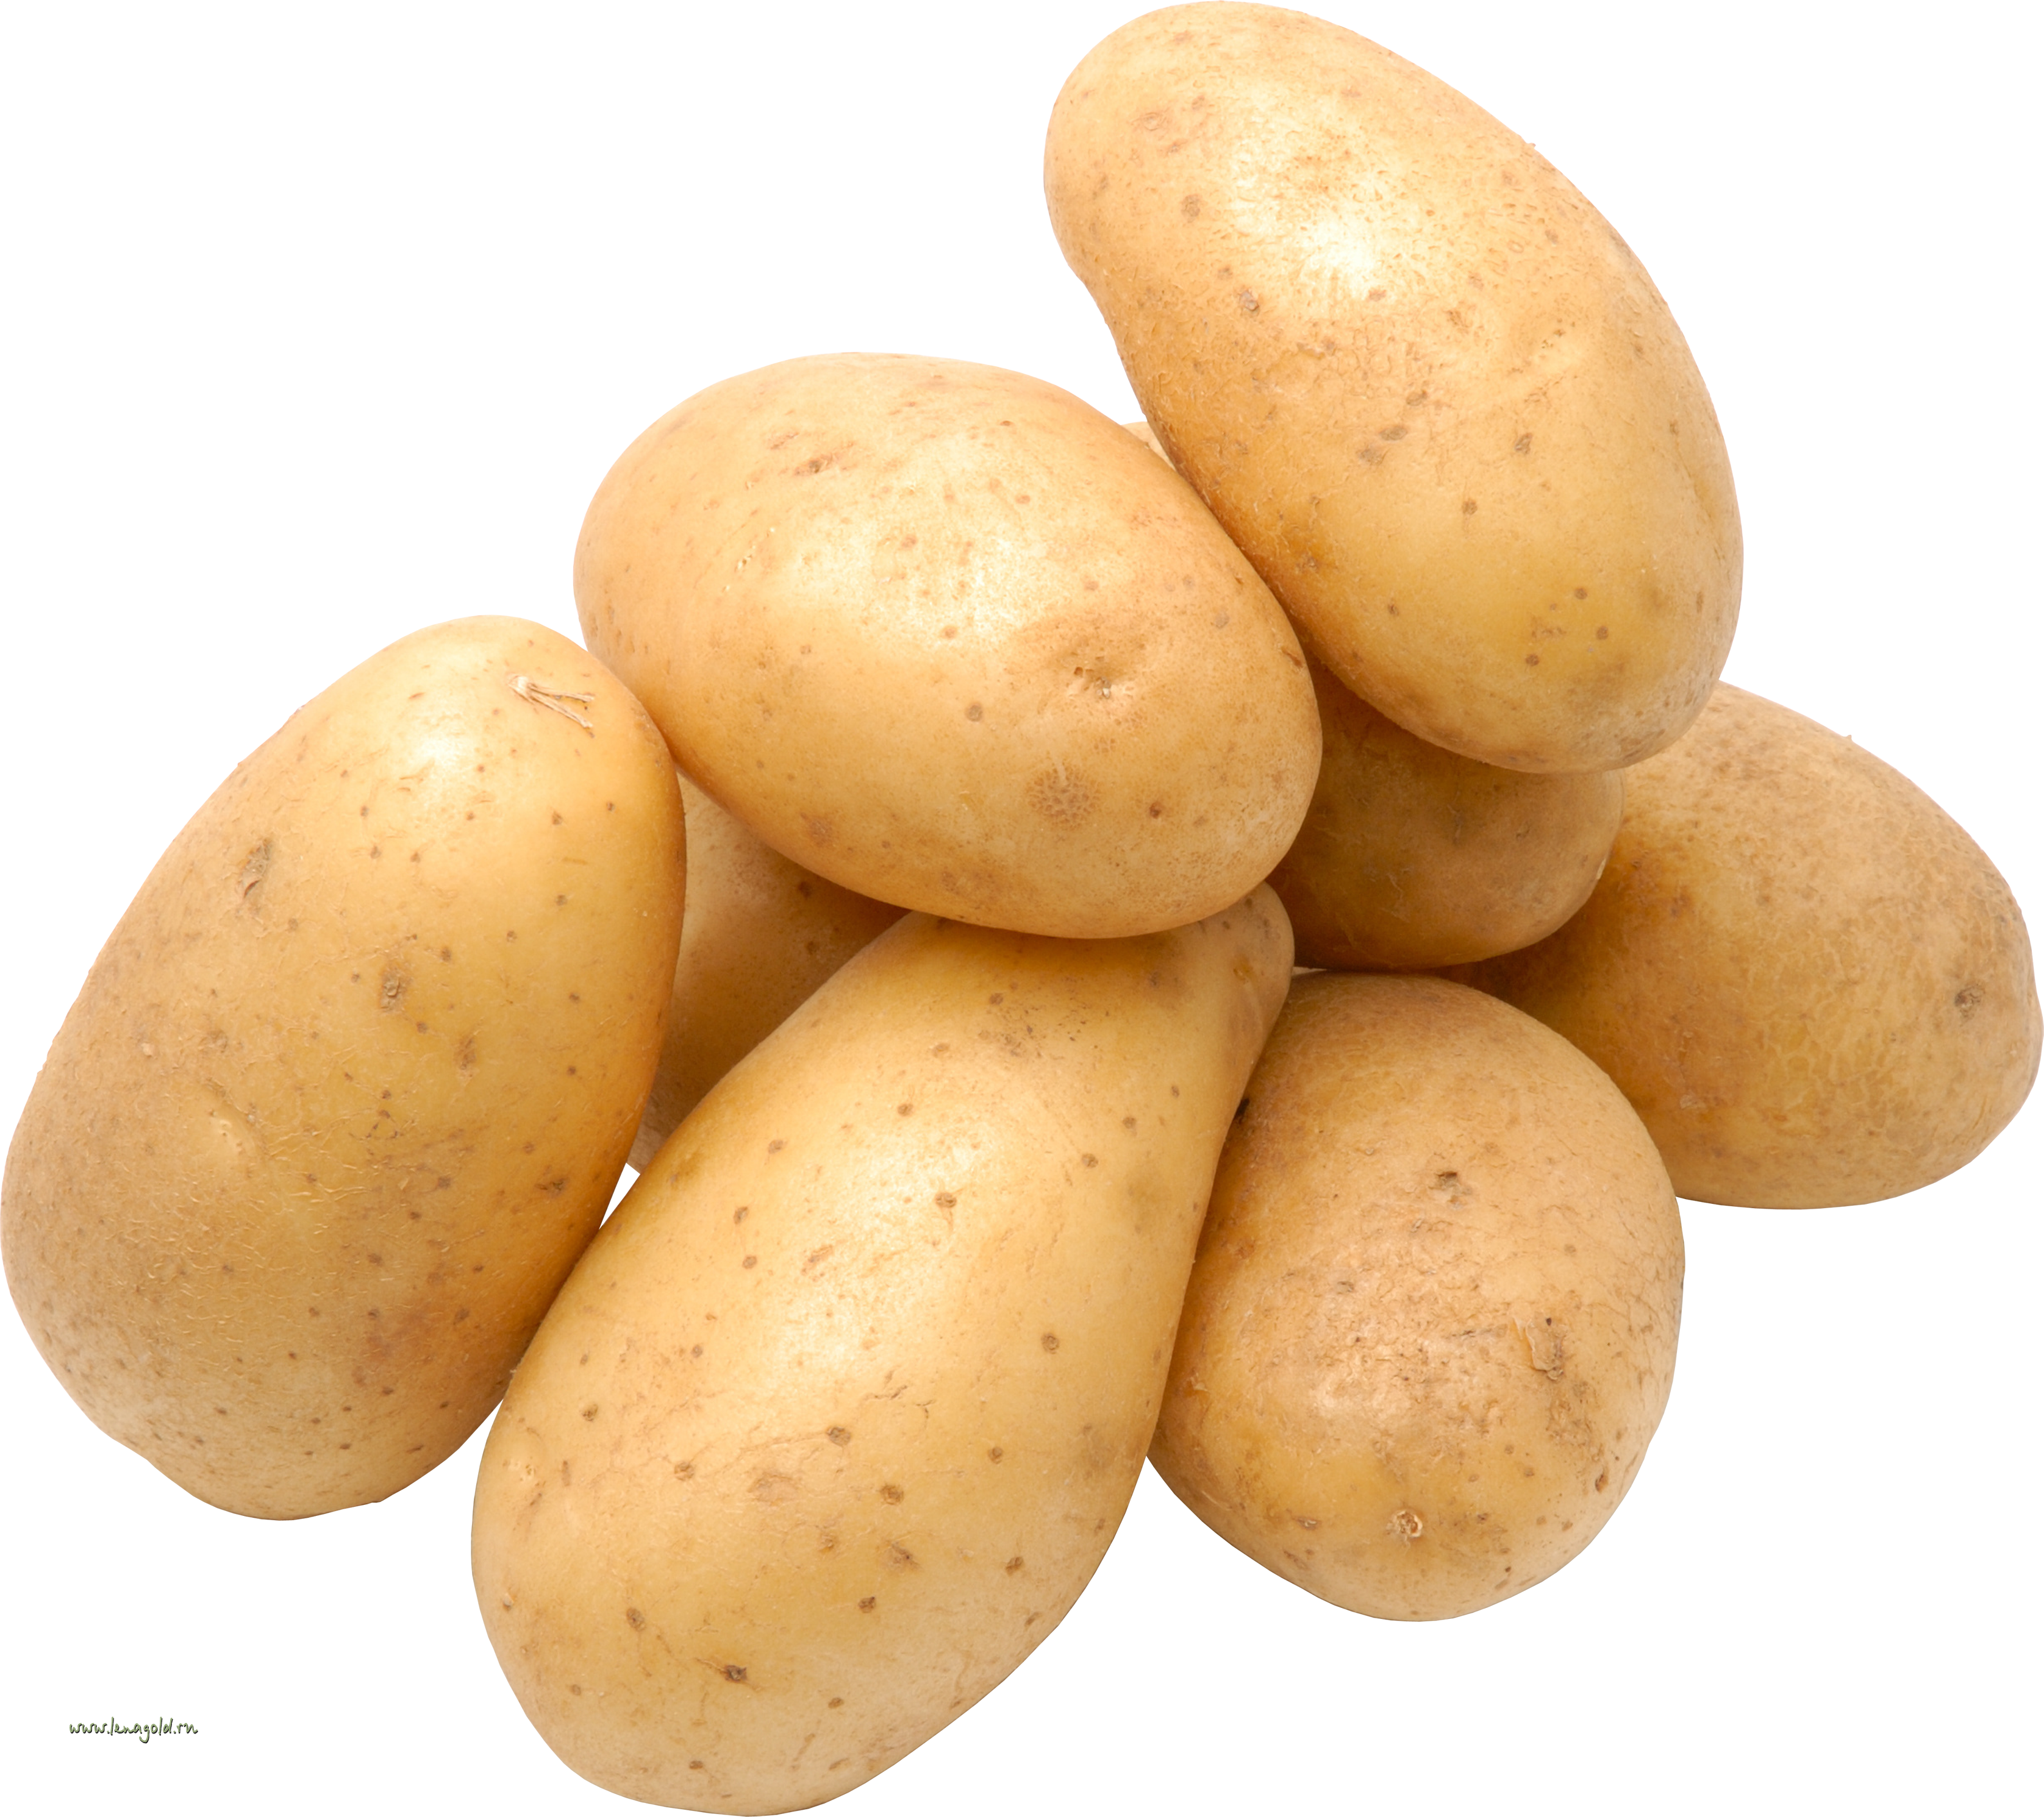
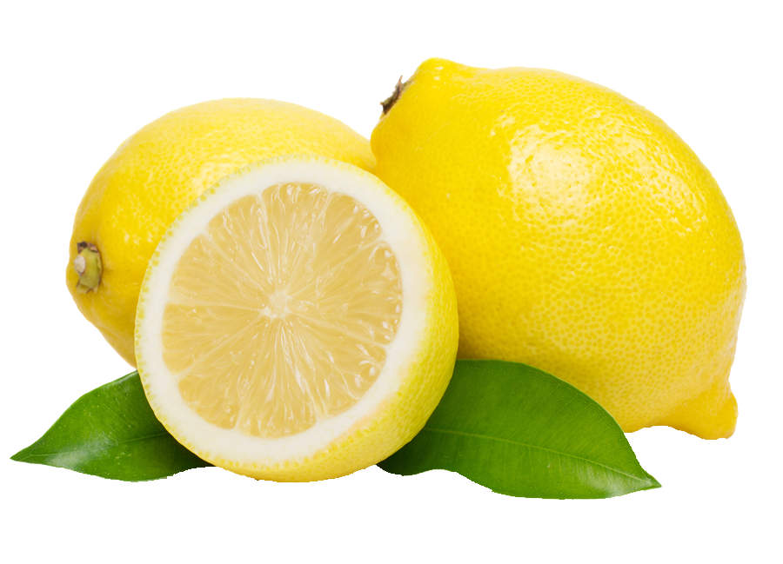
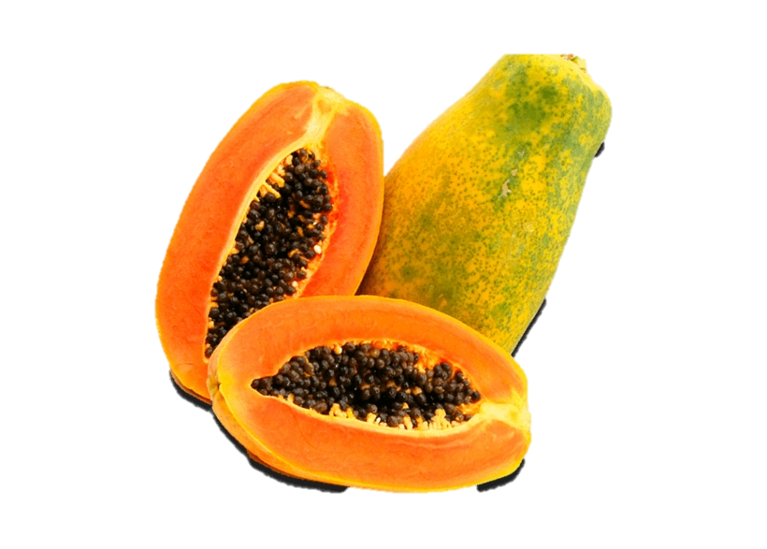
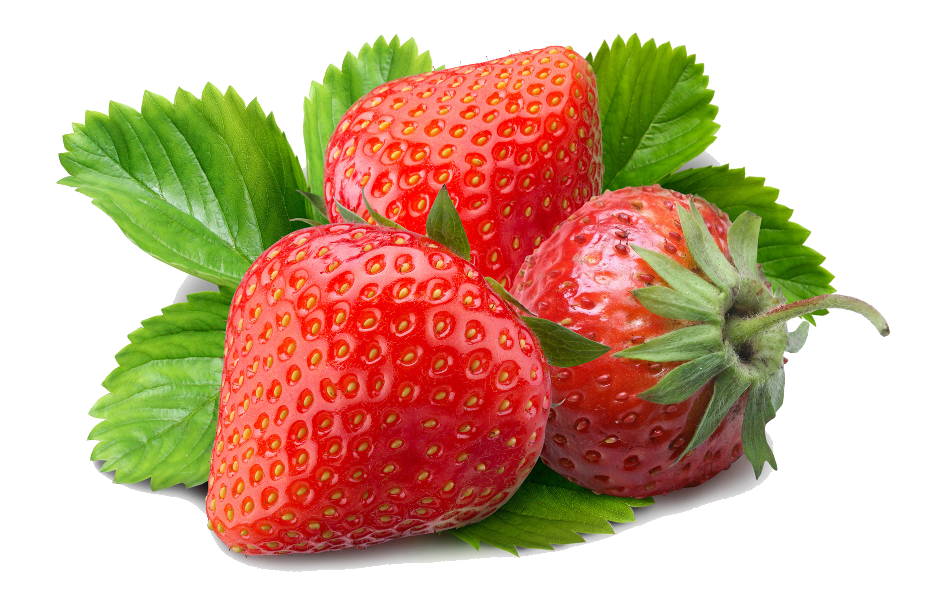
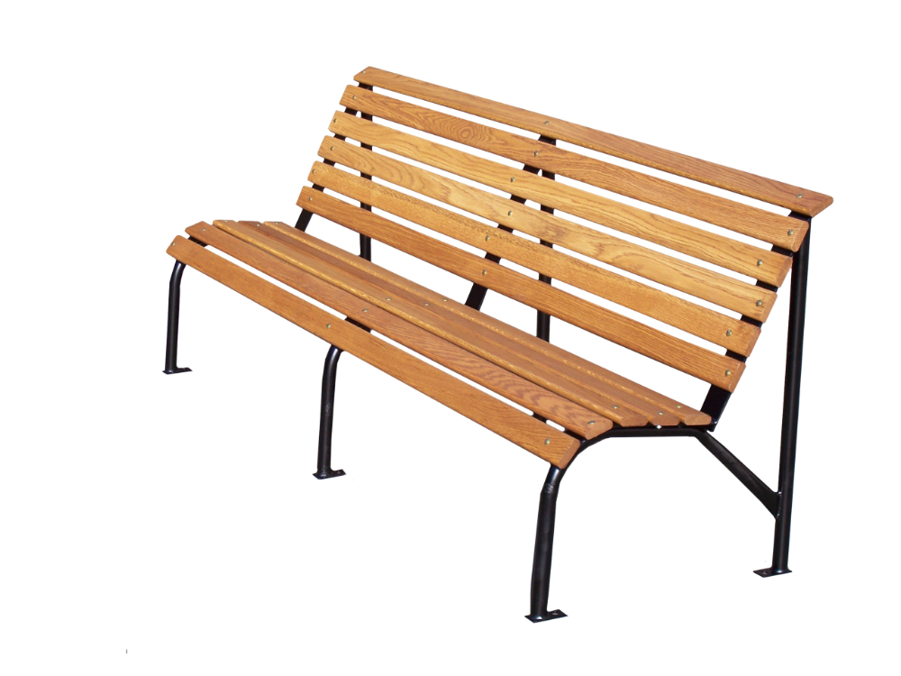
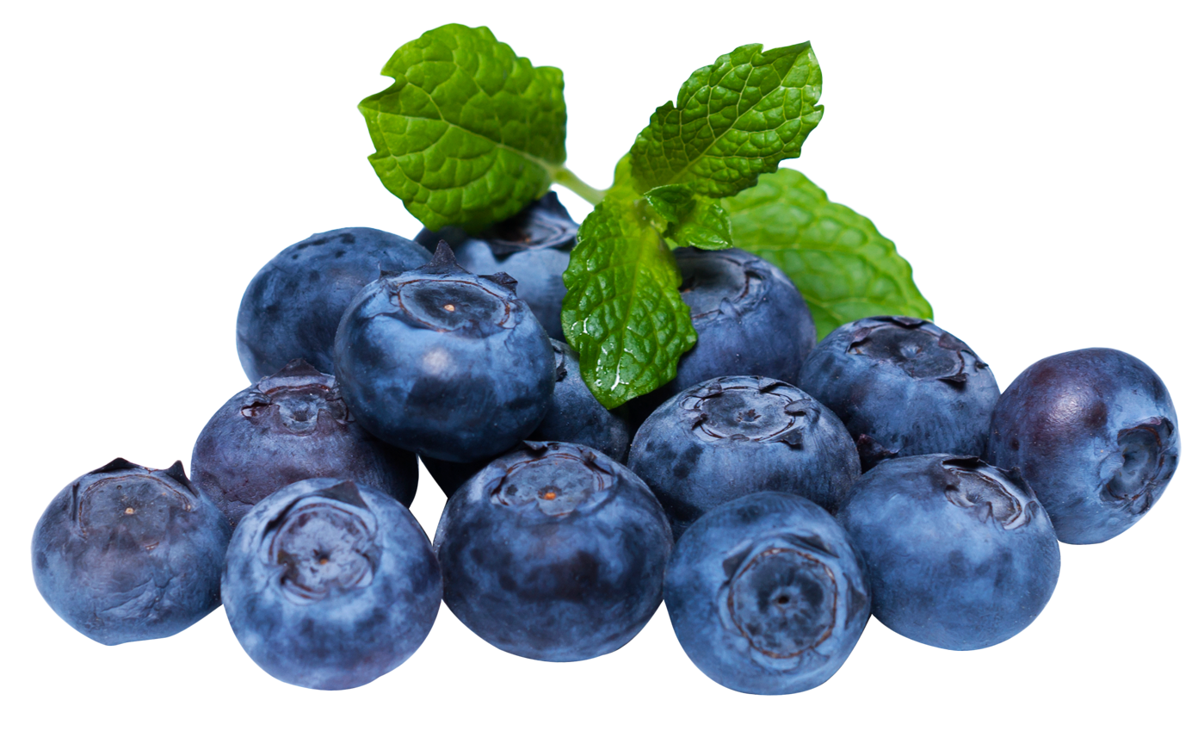
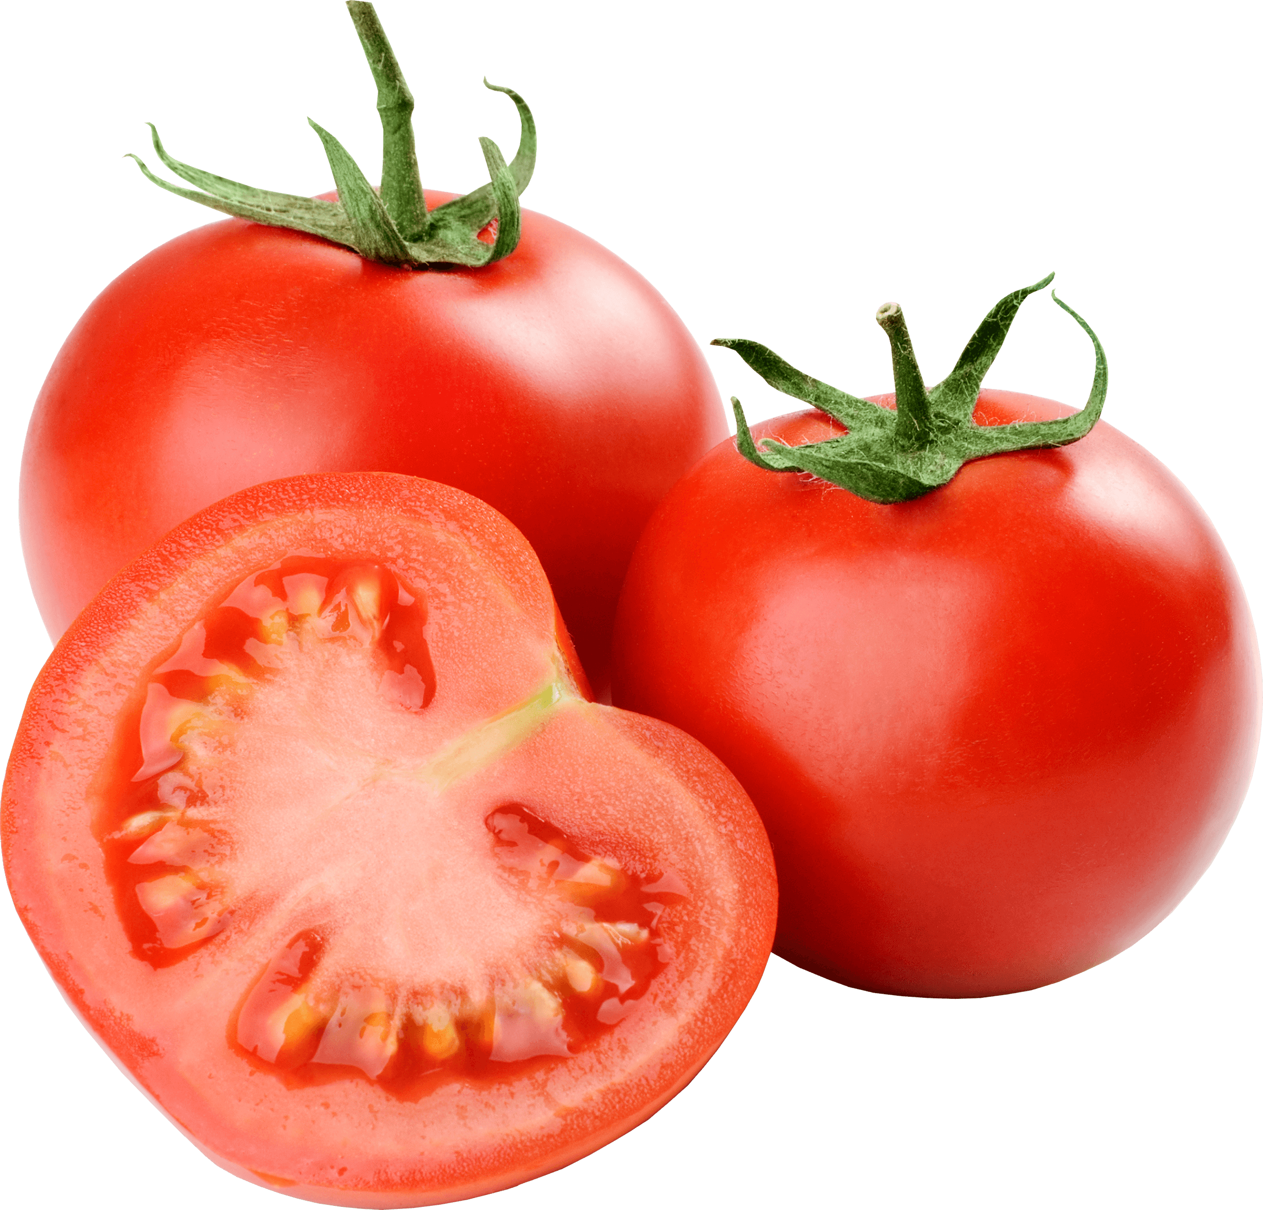
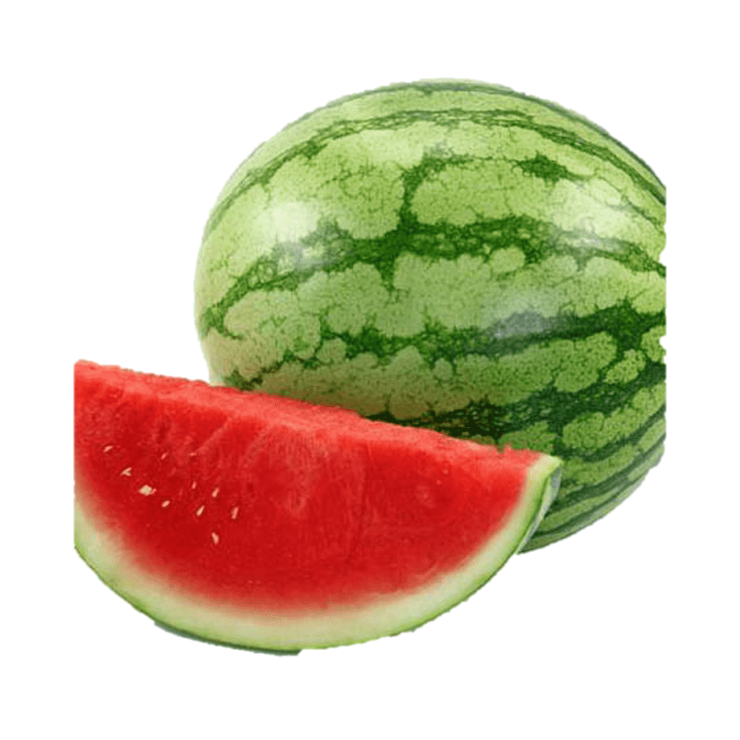
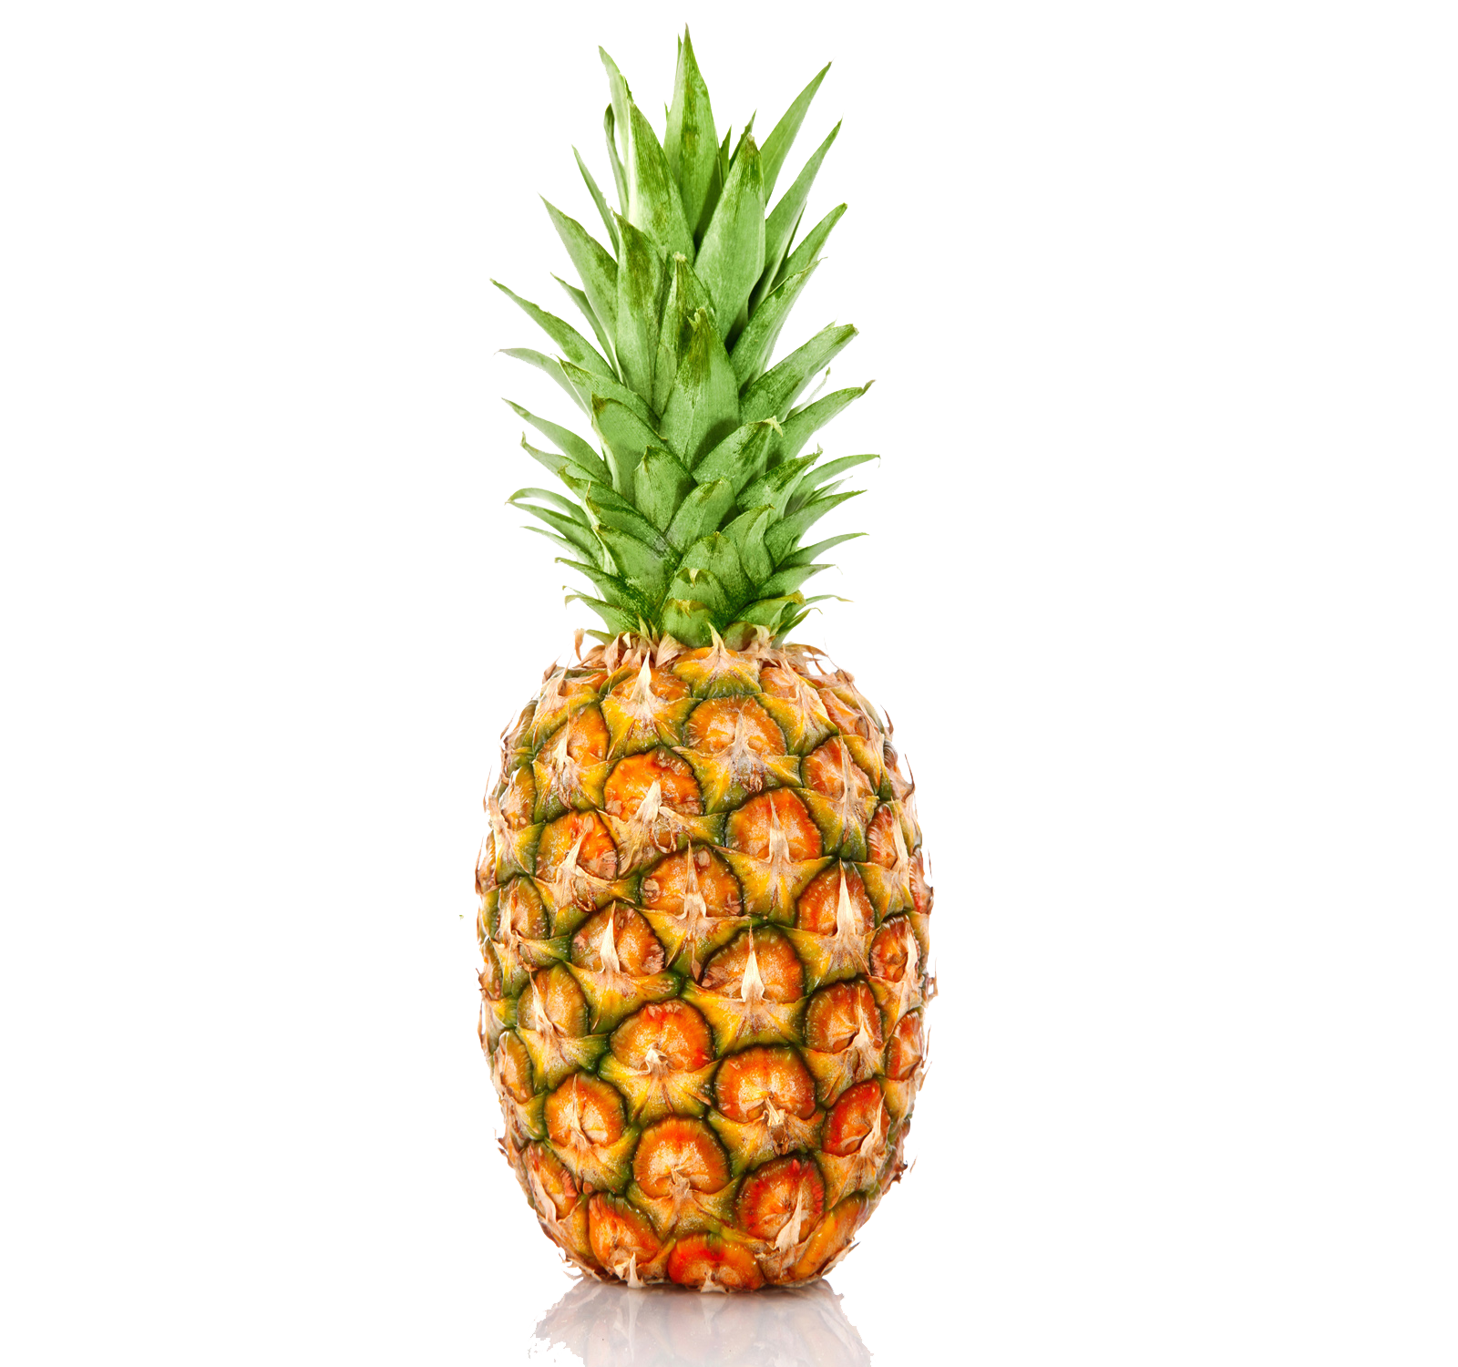
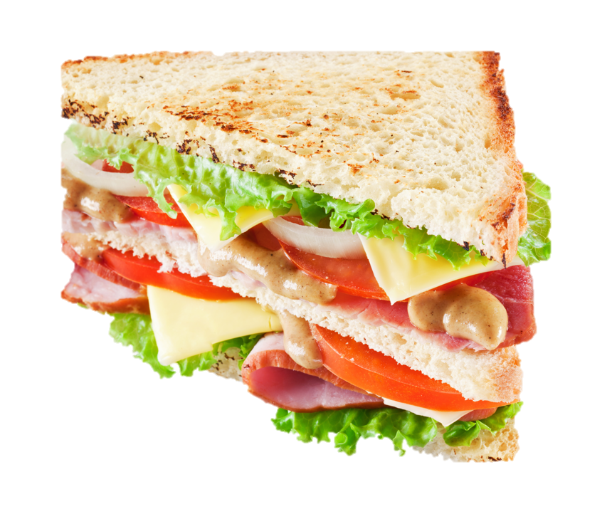
Try your best to do it. ☺
lemon - ______________
strawberry - __________
bench - ______________
tomato - _____________
pineapple - ___________
potato - _______________
papaya - _______________
blueberry - _____________
watermelon - ___________
sandwich - ____________

Slide 14
Try your best to do it. ☺
lemon - ______________
strawberry - __________
bench - ______________
tomato - _____________
pineapple - ___________
potato - _______________
papaya - _______________
blueberry - _____________
watermelon - ___________
sandwich - ____________
lemons
potatoes
strawberries
papayas
benches
blueberries
tomatoes
watermelons
pineapples
sandwiches

Slide 15
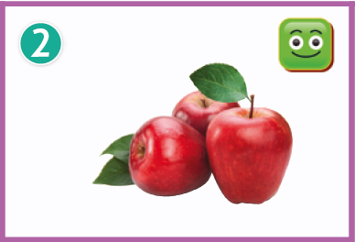
Let’s look at some fruit and tell what you like or don’t like.
apples
What fruit is in it?

Slide 16

I like / don’t like apples.
Is it a happy face or an unhappy face?
What do we say for this square?

Slide 17

表達自己喜歡或不喜歡的水果時，記得要用複數表示。
I like apples.
What do we say for this square?

Slide 18
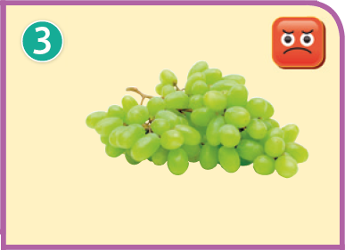
grapes
What fruit is in it?

Slide 19

I like / don’t like grapes.
Is it a happy face or an unhappy face?
What do we say for this square?

Slide 20
表達自己喜歡或不喜歡的水果時，記得要用複數表示。
I don’t like grapes.
What do we say for this square?

Slide 21
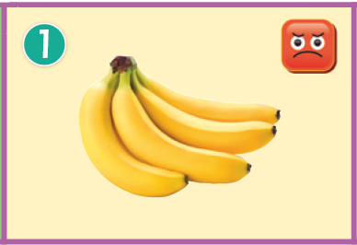

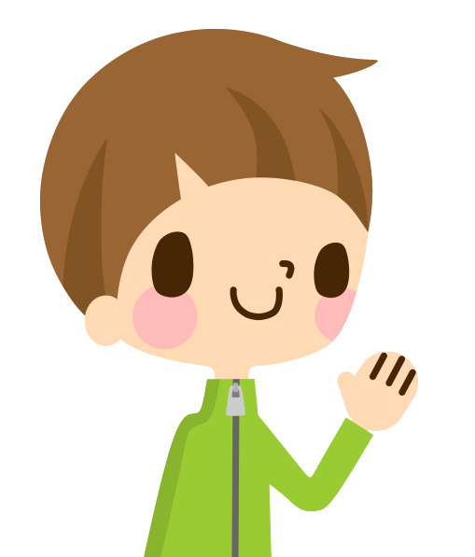
Name the fruit and tell you like or don’t like it.
bananas.
I don’t like

Slide 22
apples.
I like

Slide 23
grapes.
I don’t like

Slide 24
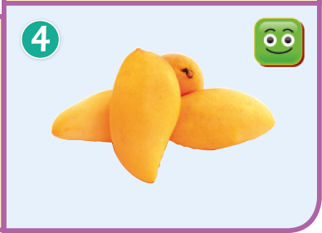
I like
mangoes.

Slide 25
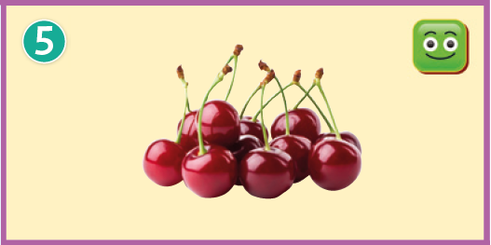
I like
cherries.

Slide 26
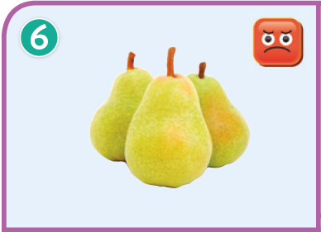
pears.
I don’t like

Slide 27
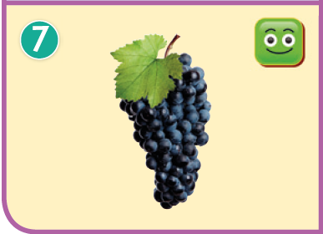
I like
grapes.

Slide 28
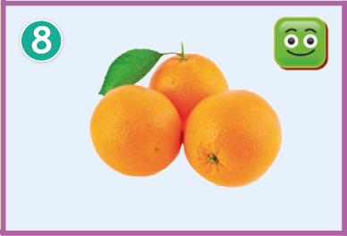
oranges.
I like

Slide 29
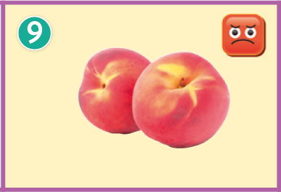
peaches.
I don’t like

Slide 30
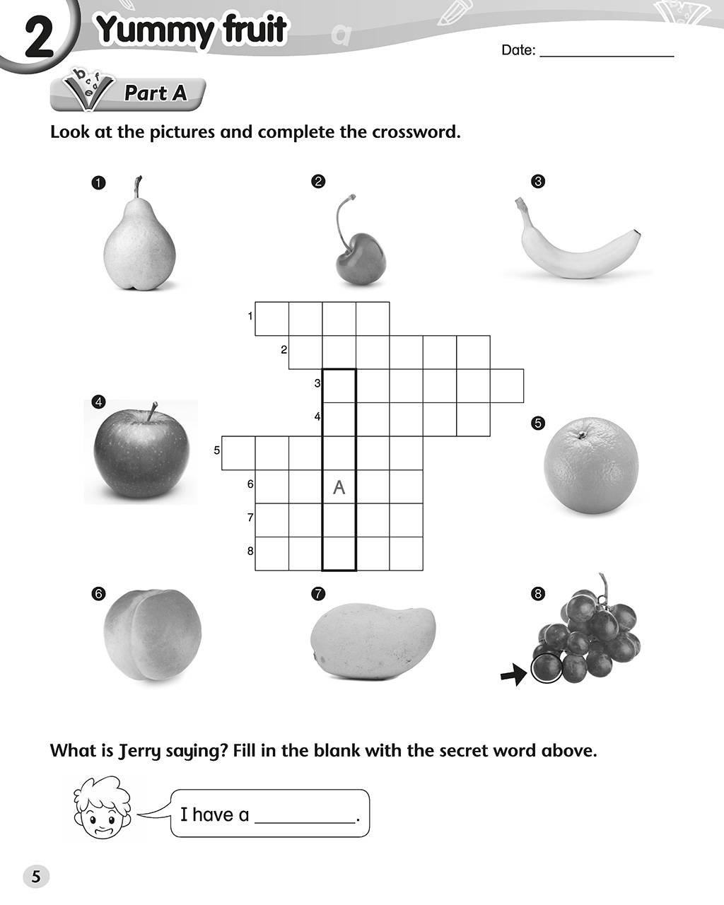
Tuesday
12th October,2021
I.P p.5
p
e
a
r
a
*請用小楷 填寫。
(不用大楷)

Slide 31
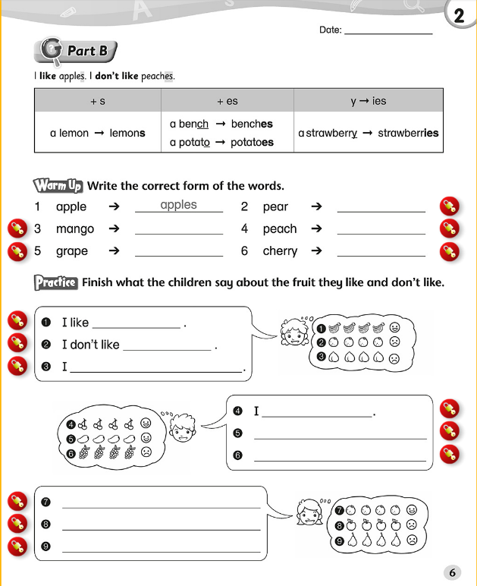
Tuesday
12th October,2021
I.P p.6
pears
*請把名詞變成複數。
bananas
*根據圖中的表情符號，以like / don’t like表達喜歡或不喜歡的水果。
*記得水果要用複數表示。
oranges

Slide 32

Let’s revise Ch.2 vocab (1-10)
請點擊發音
fruit (水果)
pear (梨)
orange (橙)
banana (香蕉)
apple (蘋果)
grape (葡萄)
peach (桃子)
mango (芒果)
cherry (櫻桃)
want (想要)
orange
banana
apple
grape
peach
mango
cherry
want

Slide 33
The End

